Slide 1

WPA2 Wi‑Fi Cracking with an ESP32 Marauder
Cybersecurity Capstone Tutorial – Darasimi Ogunbinu‑Peters
Notes:
Slide 1 – Title
“WPA2 Wi-Fi Cracking with an ESP32 Marauder”
“Hi everyone, my name is Darasimi Ogunbinu-Peters. For my cybersecurity capstone tutorial, I decided to build a DIY ESP32 Marauder and use it to demonstrate a full WPA2 Wi-Fi cracking workflow on a lab router that I had written permission to test.
The big goals for this project were:
First, to actually build the Marauder from raw parts, not just buy a finished board.
Second, to walk through the end-to-end attack chain: capture a WPA2 handshake, convert it for Hashcat, and recover the password.
And finally, to reflect on what this means for real-world Wi-Fi security and why strong passwords and good configs matter.”

Slide 2
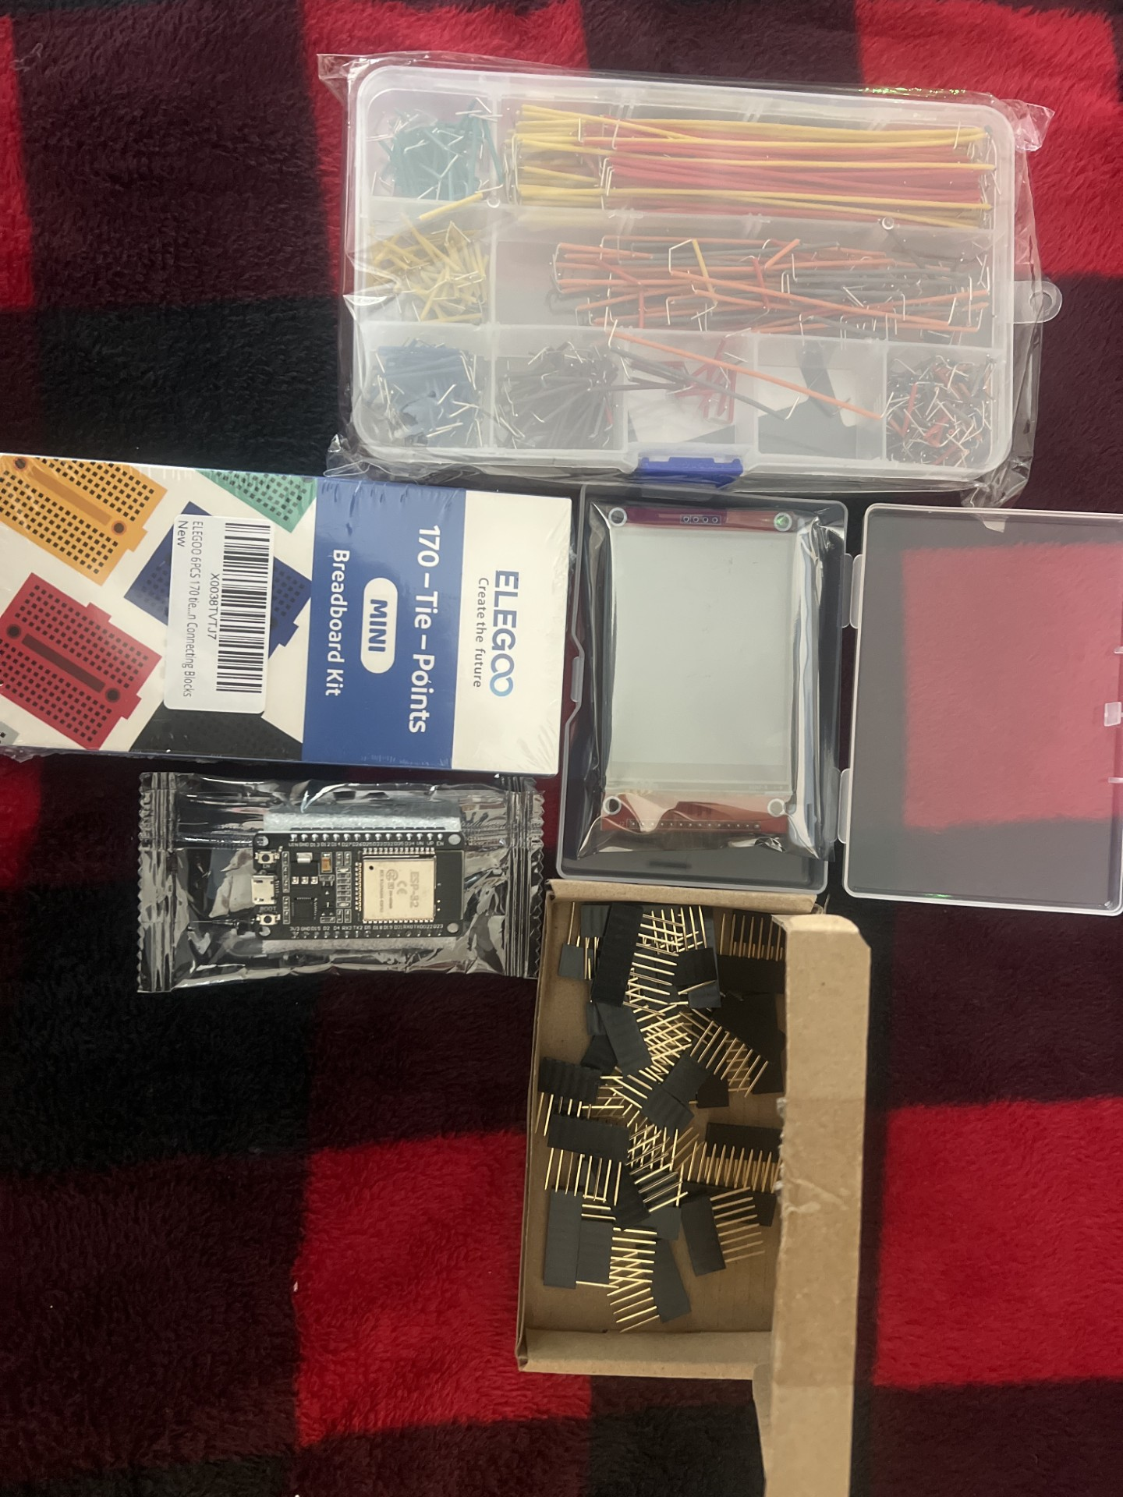
Hardware: ESP32 Marauder Build
ESP32 development board
2.8" SPI TFT display with microSD slot
Mini breadboards, jumper wires, header pins
Soldering iron, microscope, and basic tools
Notes:
Slide 2 – Hardware: ESP32 Marauder Build
“To start, here’s the hardware stack I used:
An ESP32 dev board
A 2.8" SPI TFT display with a microSD slot
Mini breadboards, jumper wires, and header pins
Plus a soldering iron, microscope, and basic tools.
The plan was: build my own Marauder, fix any hardware issues, then use this setup as a low-cost Wi-Fi testing platform.”

Slide 3
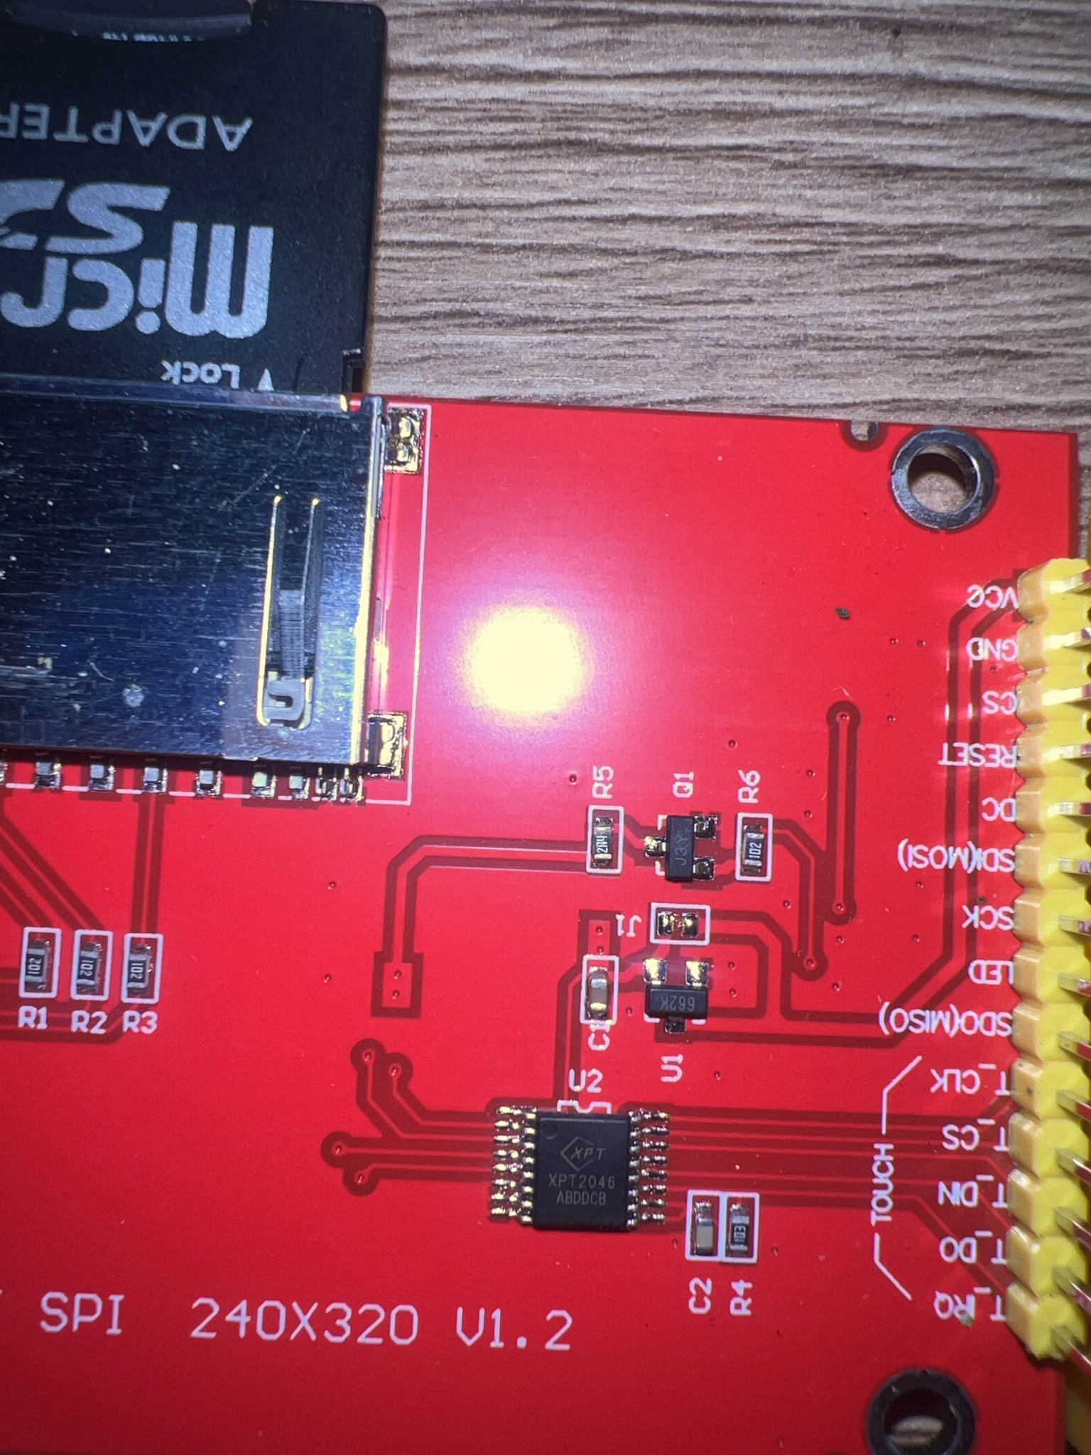
Inspecting the TFT + microSD Module
Verified the TFT module and microSD slot under bright lighting.
Identified issues with the SD card header area that would affect PCAP saving. Note that J1 will need to be soldered together for SD card power
Notes:
Slide 3 – Inspecting the TFT + microSD Module
“Before wiring anything, I inspected the TFT and microSD slot under bright lighting. Right away we noticed some sketchy soldering around the SD card header. Since Marauder needs the SD card to save PCAP files, any bad joints here would break the whole capture pipeline. So hardware reliability became my first real challenge.”

Slide 4
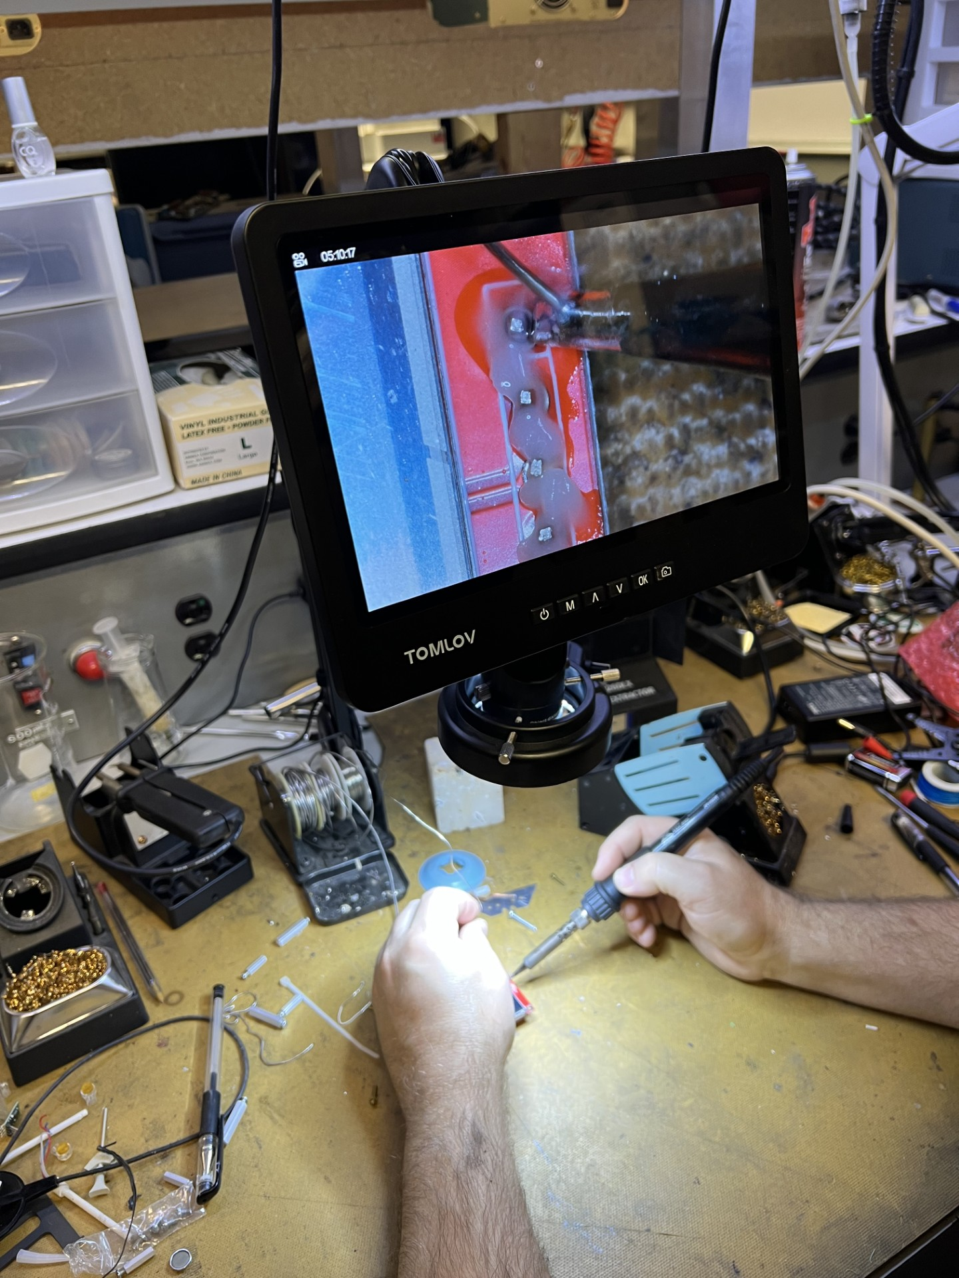
Fixing the SD Card Header (Soldering)
Used a microscope to locate missing/weak solder joints on the SD header pins.
Re‑flowed solder and confirmed solid connections on all pins.
Notes:
Slide 4 – Fixing the SD Card Header
“Under the microscope we found missing or weak solder joints on the SD pins. We cleaned the pads, re-flowed each pin, and made sure everything had a shiny, solid connection.
This step was huge, because if the SD card isn’t talking to the board, you don’t get PCAPs, and then you can’t move on to Wireshark or Hashcat at all.”

Slide 5
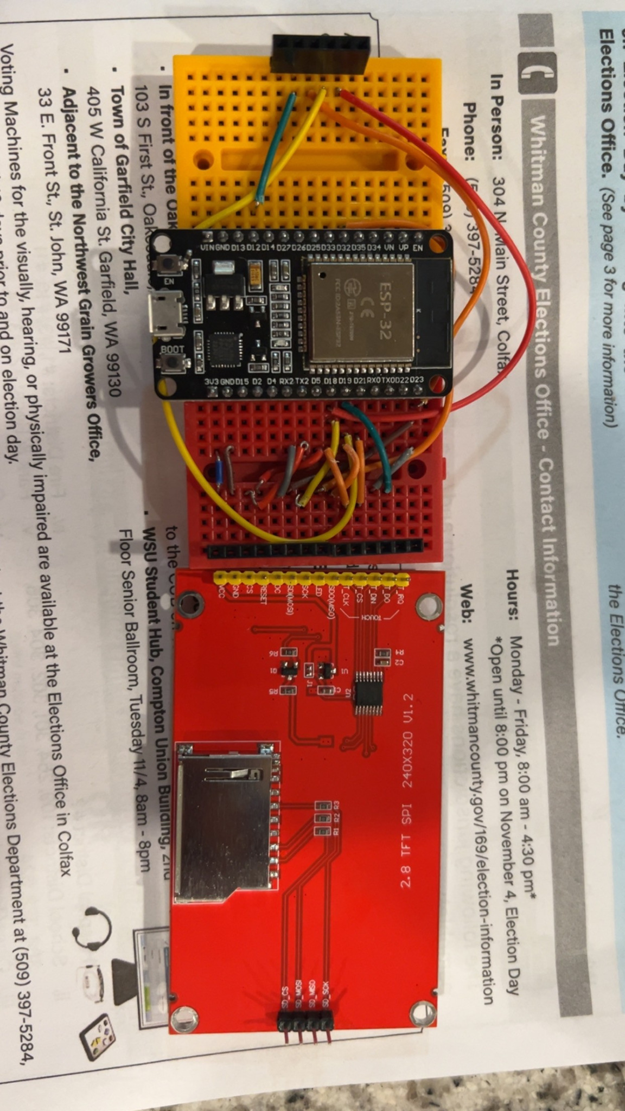
Breadboard Wiring: ESP32 + TFT + SD
Mounted the ESP32 and TFT on mini breadboards.
Connected power, SPI, control, and touch pins using jumper wires.
Notes:
Slide 5 – Breadboard Wiring: ESP32 + TFT + SD
“Once the SD header was solid, I mounted the ESP32 and the TFT on mini breadboards. I wired up:
Power and ground
SPI lines for the display and SD card
Control pins like reset and D/C
And the touch pins, even though I didn’t end up using touch in this demo.
This is where I spent a lot of time double-checking connections and chasing small wiring mistakes.”

Slide 6
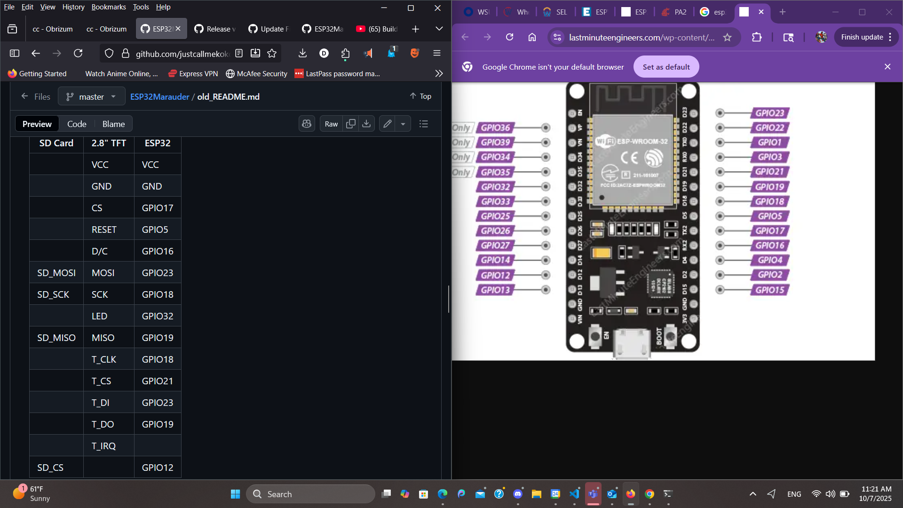
GPIO Wiring Cheat Sheet
Mapped TFT and SD card pins to ESP32 GPIOs.
Used this diagram as a reference while wiring and troubleshooting.
Notes:
Slide 6 – GPIO Wiring Cheat Sheet
“To keep my sanity, I built this GPIO cheat sheet that maps each TFT and SD pin to the correct ESP32 GPIO. This made troubleshooting way easier. Any time the screen stayed black or the SD card didn’t mount, I could just go back to this chart and verify each jumper instead of guessing.”

Slide 7
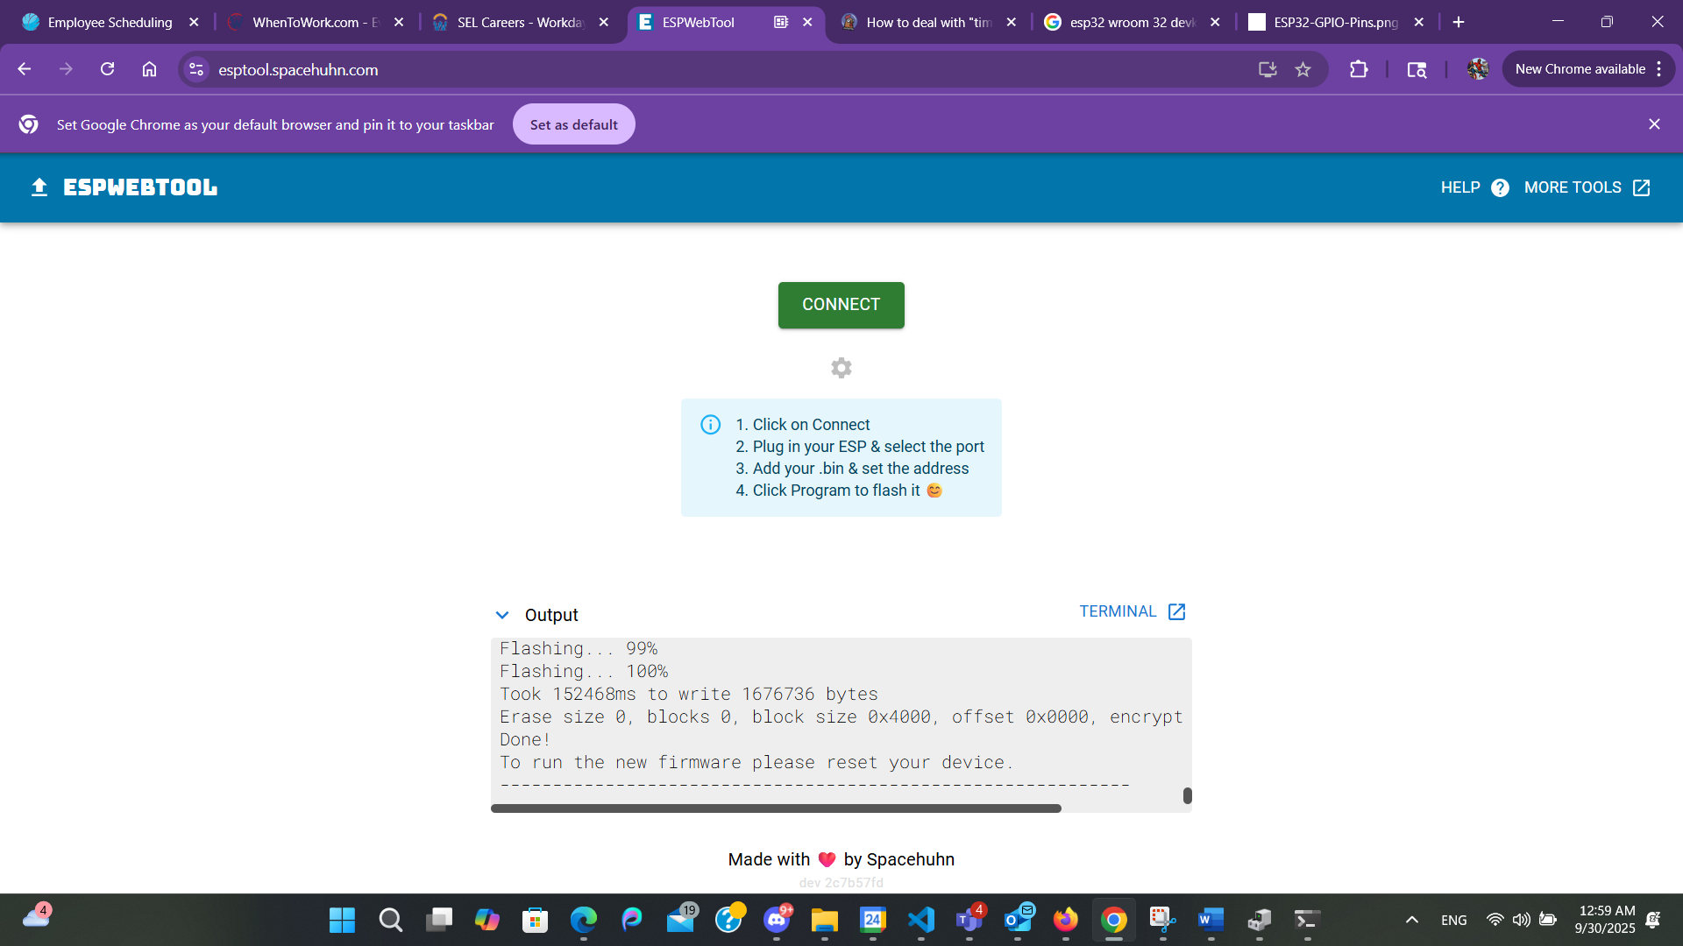
Flashing the ESP32 Marauder Firmware
Used ESP Web Tool in the browser to flash the Marauder .bin file.
Selected the correct COM port, ran the flasher, and waited for 100% completion.
Reset the ESP32 to boot into Marauder.
Notes:
Slide 7 – Flashing the ESP32 Marauder Firmware
“With hardware ready, I flashed the Marauder firmware using the ESP Web Tool in my browser. I connected the ESP32, selected the right COM port, loaded the .bin file, and let it run until it hit 100%. After that, I reset the board so it could boot straight into Marauder.”

Slide 8
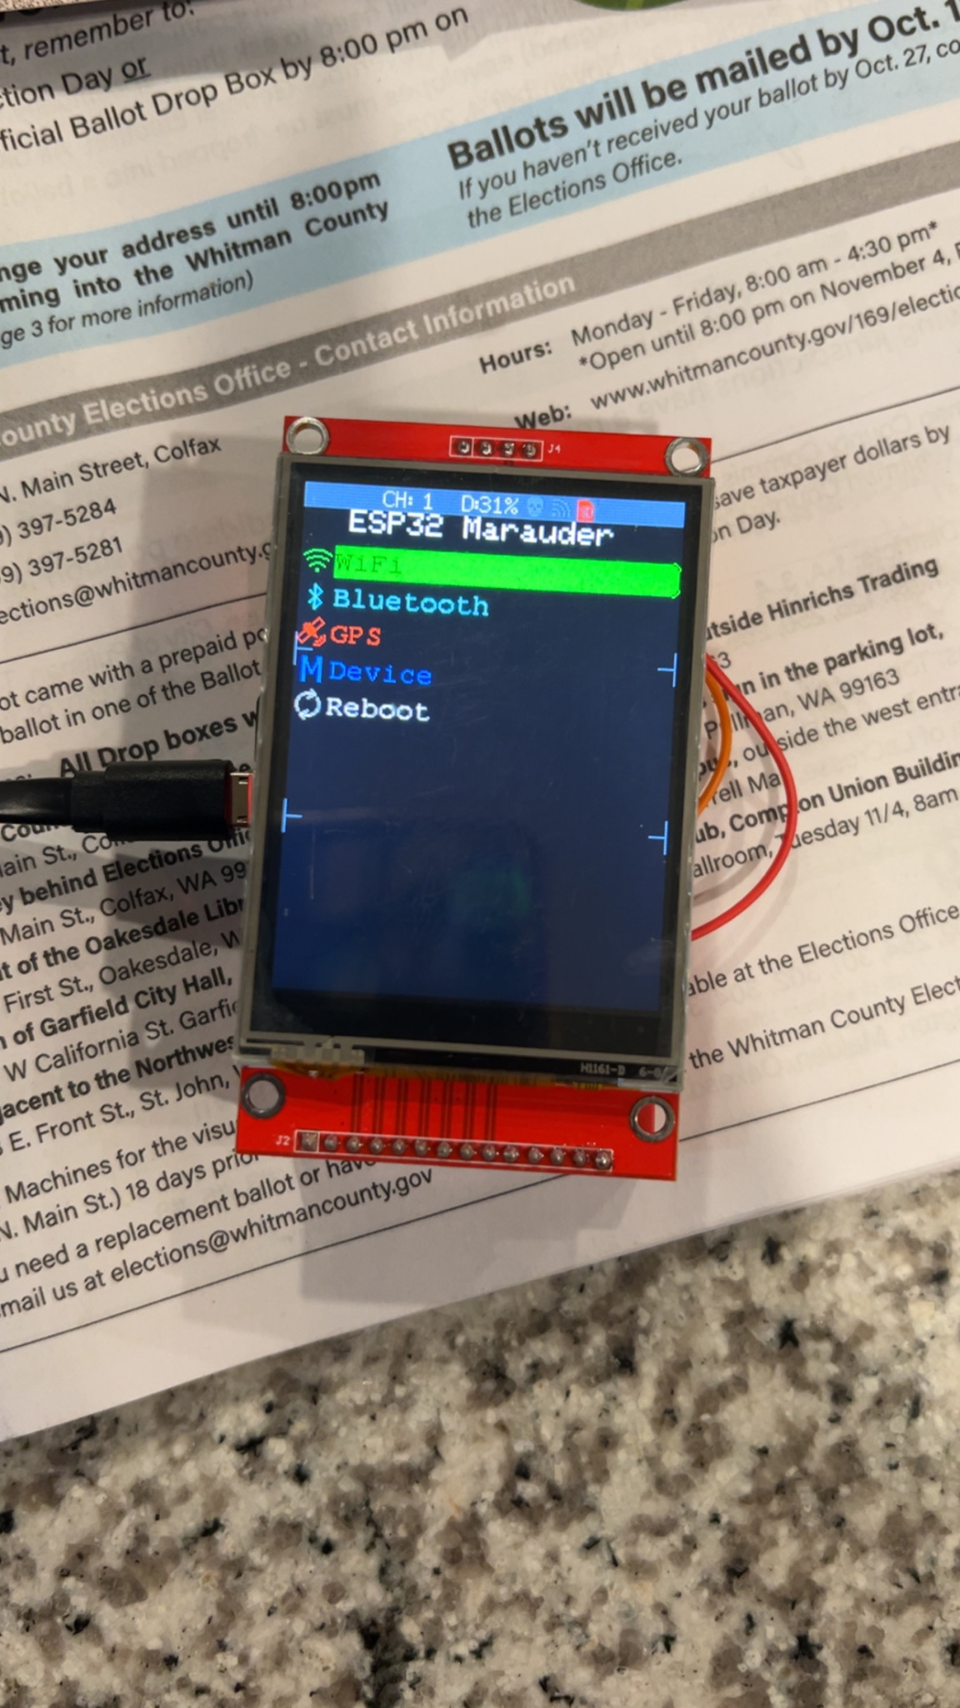
First Boot: Marauder Main Menu
Successful boot showed the ESP32 Marauder main menu on the TFT.
Menu exposes WiFi, Bluetooth, GPS (unused), Device, and Reboot options.
Notes:
Slide 8 – First Boot: Marauder Main Menu
“On the first boot, this is what I saw: the ESP32 Marauder main menu on the TFT.
You can see options for Wi-Fi, Bluetooth, GPS, Device settings, and Reboot. For this project I focused strictly on the Wi-Fi tools plus some device settings needed to save captures.”

Slide 9
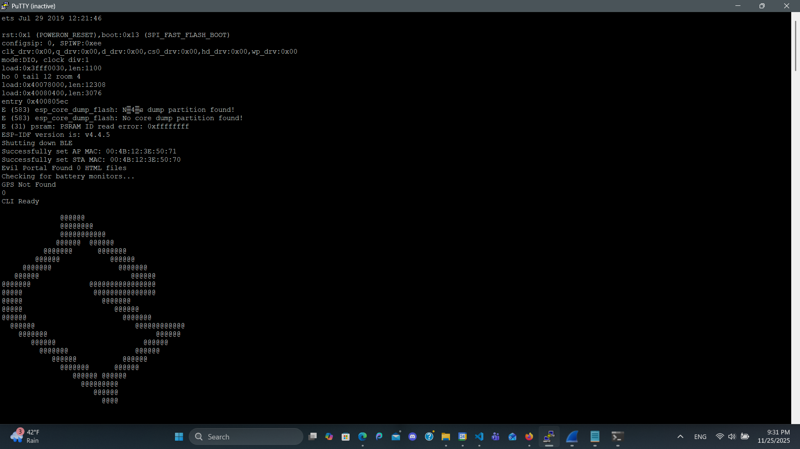
Serial Console: Initial Startup Log
Connected with PuTTY to the ESP32 serial port for CLI access.
Verified firmware version, AP/STA MACs, and that the CLI is ready.
Notes:
Slide 9 – Serial Console: Initial Startup Log
“I also connected over serial using PuTTY, which gives you a CLI with more detailed output. Here you can see the boot log, firmware version, and that the CLI says Ready.
Having both the screen UI and the CLI is nice: if something goes wrong, the serial output usually tells you why.”

Slide 10
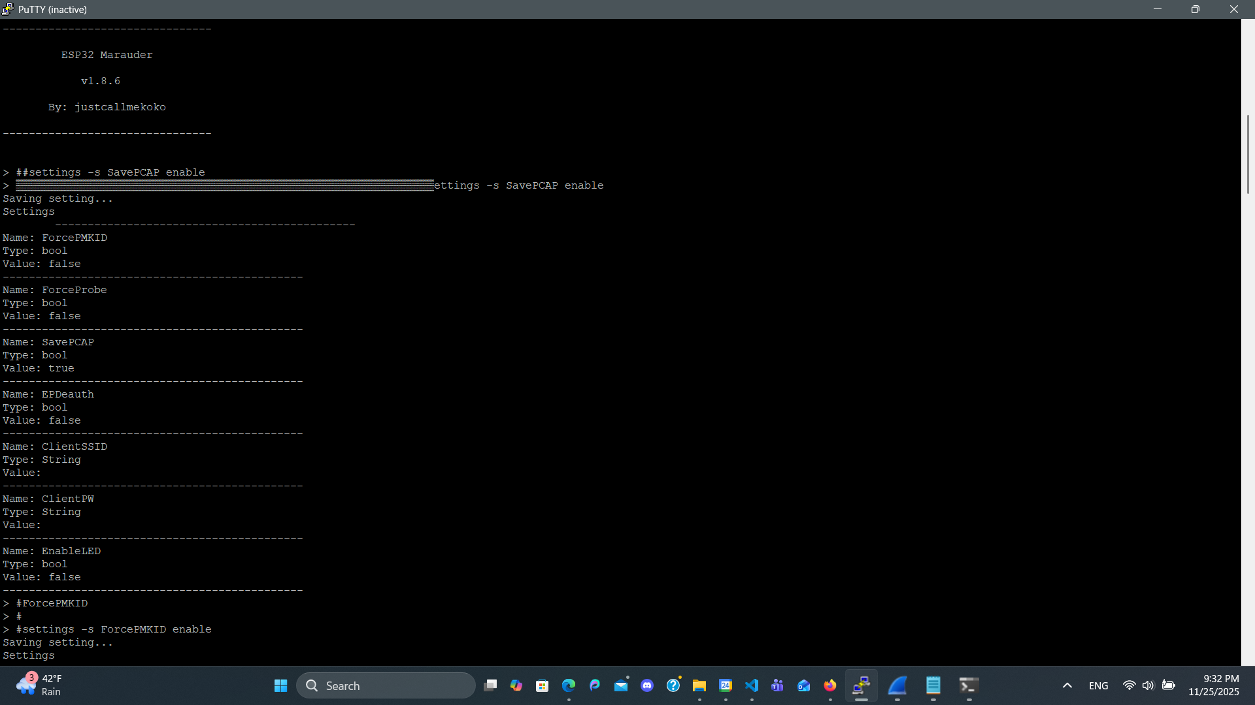
Configuring Capture Settings
Used the CLI 'settings' command to enable SavePCAP so captures go to the SD card.
Could’ve Enabled ForcePMKID as well to collect PMKID data for WPA2 cracking.
Notes:
Slide 10 – Configuring Capture Settings
“Before I started any attacks, I went into the settings command.
I enabled SavePCAP, so all wireless captures would be written to the SD card.
I also enabled ForcePMKID so Marauder would aggressively try to grab PMKID data and EAPOL messages for WPA2 cracking.
Getting these settings right up front saved me from doing a whole scan and then realizing nothing was written to disk.”

Slide 11
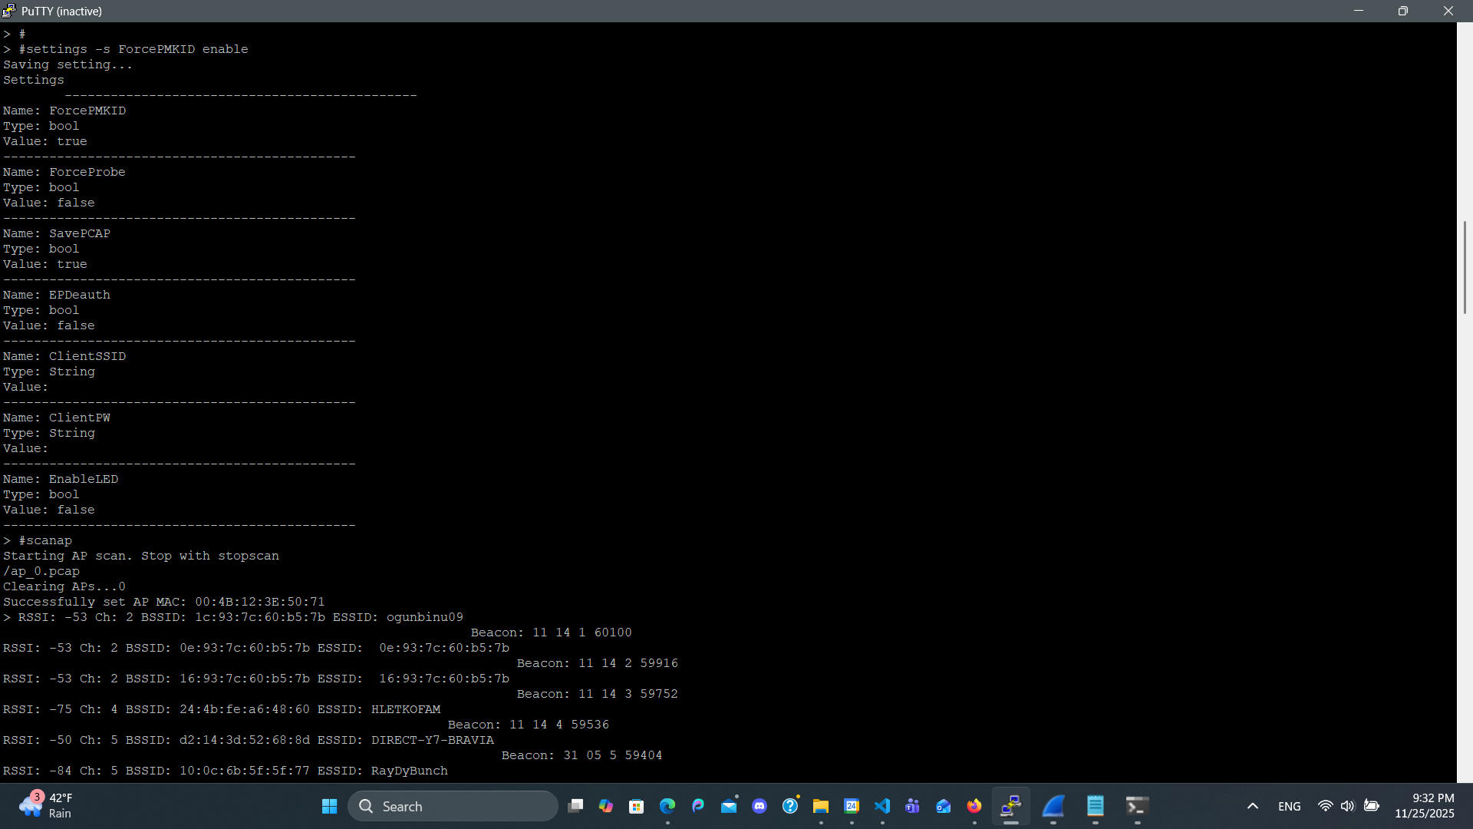
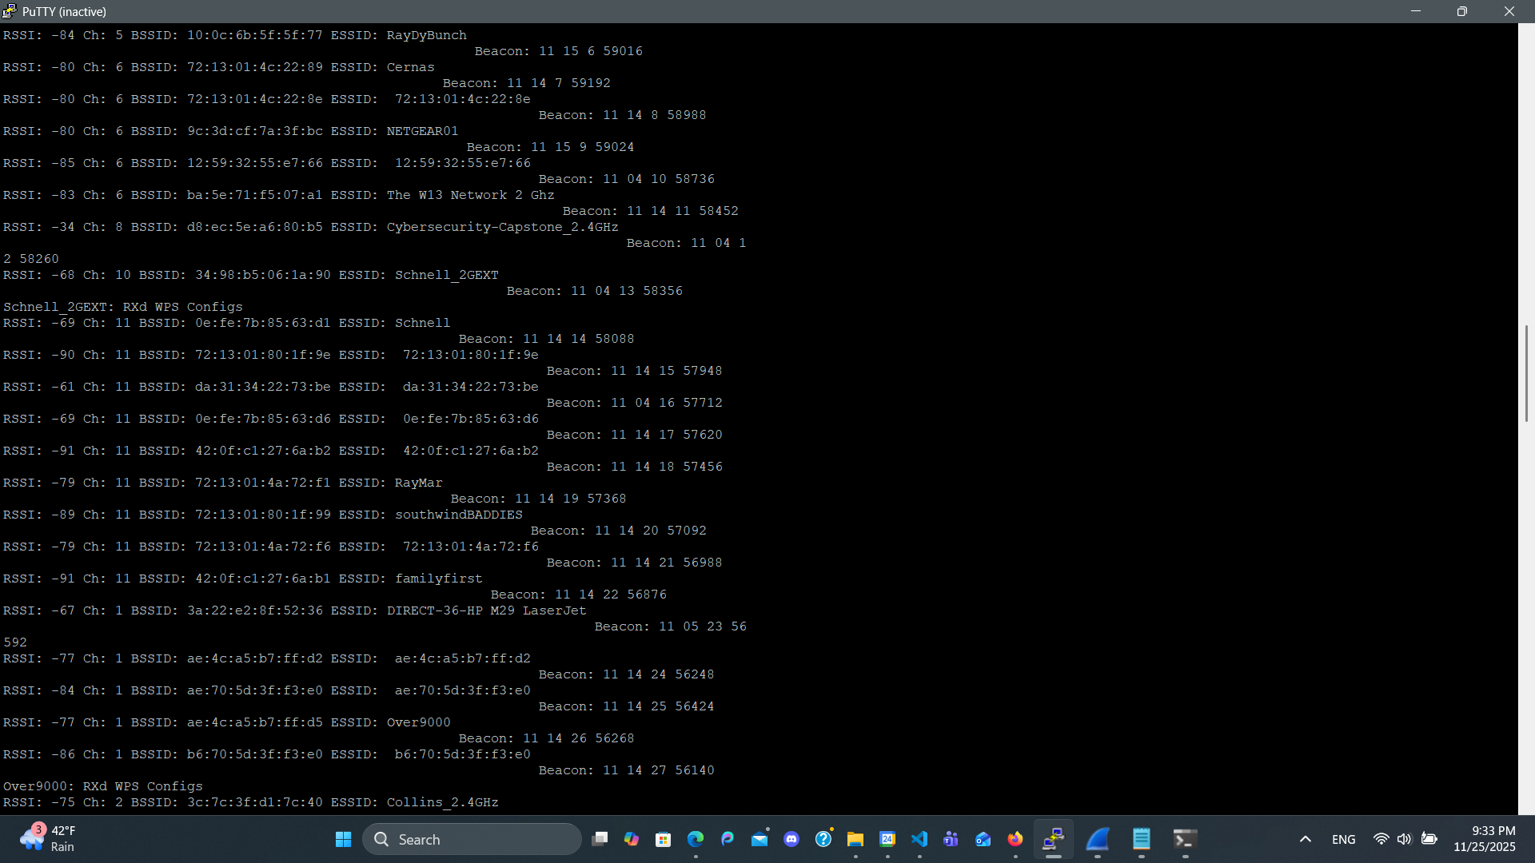
Scanning Nearby Wi‑Fi Networks
Ran 'scanap' to discover nearby access points.
Stopped the scan and used 'flist -a' to list APs with channel and RSSI.
Identified the target SSID: Cybersecurity‑Capstone_2.4GHz.
Notes:
Part 2 – Penetration Testing in Action (Phases 1–9)
Slide 11 – Scanning Nearby Wi-Fi Networks
“Now we move into the actual penetration-testing workflow. Phase 1 was simple: run scanap to discover nearby access points.
Marauder printed out a list with channel, BSSID, SSID, and signal strength. When I was done, I used flist -a to list everything it found with their channels and RSSI values.”

Slide 12
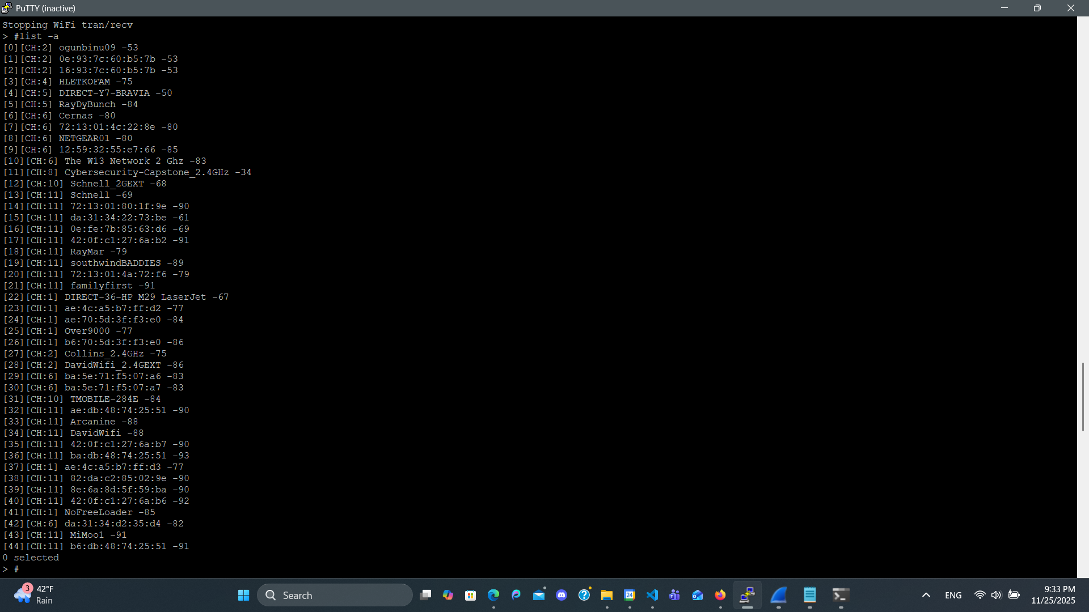
Selecting the Target Capstone AP
From the AP list, selected the capstone lab router with written permission.
Confirmed channel and signal strength before starting capture.
Notes:
Slide 12 – Selecting the Target Capstone AP
“From that list, I picked the Cybersecurity-Capstone_2.4GHz router. This is a lab router that my professor explicitly told us we could pen-test.
I verified:
The SSID
The BSSID
And the channel, so I could tune Marauder to the right frequency before capturing anything.”

Slide 13
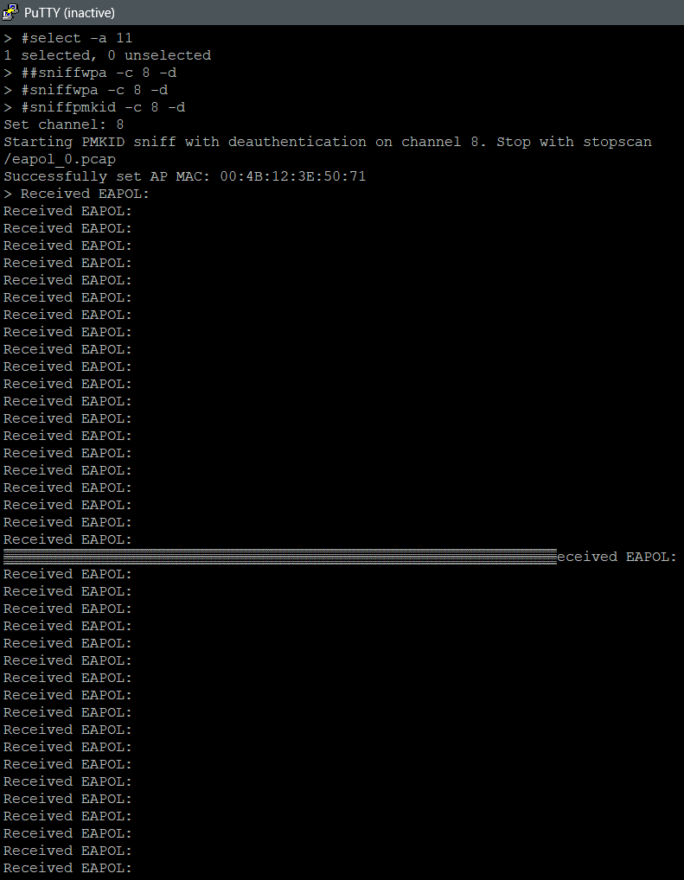
Sniffing WPA2 Handshakes and PMKID
Used 'sniffpmkid' / 'sniffwpa' with deauthentication to trigger new handshakes.
Marauder reported repeated 'Received EAPOL' messages while capturing.
Capture files (ap_0.pcap, eapol_0.pcap) were saved to the SD card.
Notes:
Slide 13 – Sniffing WPA2 Handshakes and PMKID
“Phase 2 and 3 were about capturing the cryptographic material:
I used sniffpmkid and sniffwpa with deauthentication enabled, which forces clients to reconnect.
As devices re-joined the network, Marauder spammed Received EAPOL: in the CLI.
Those EAPOL messages are part of the WPA2 4-way handshake. Marauder saved them into files like ap_0.pcap and eapol_0.pcap on the SD card.”

Slide 14
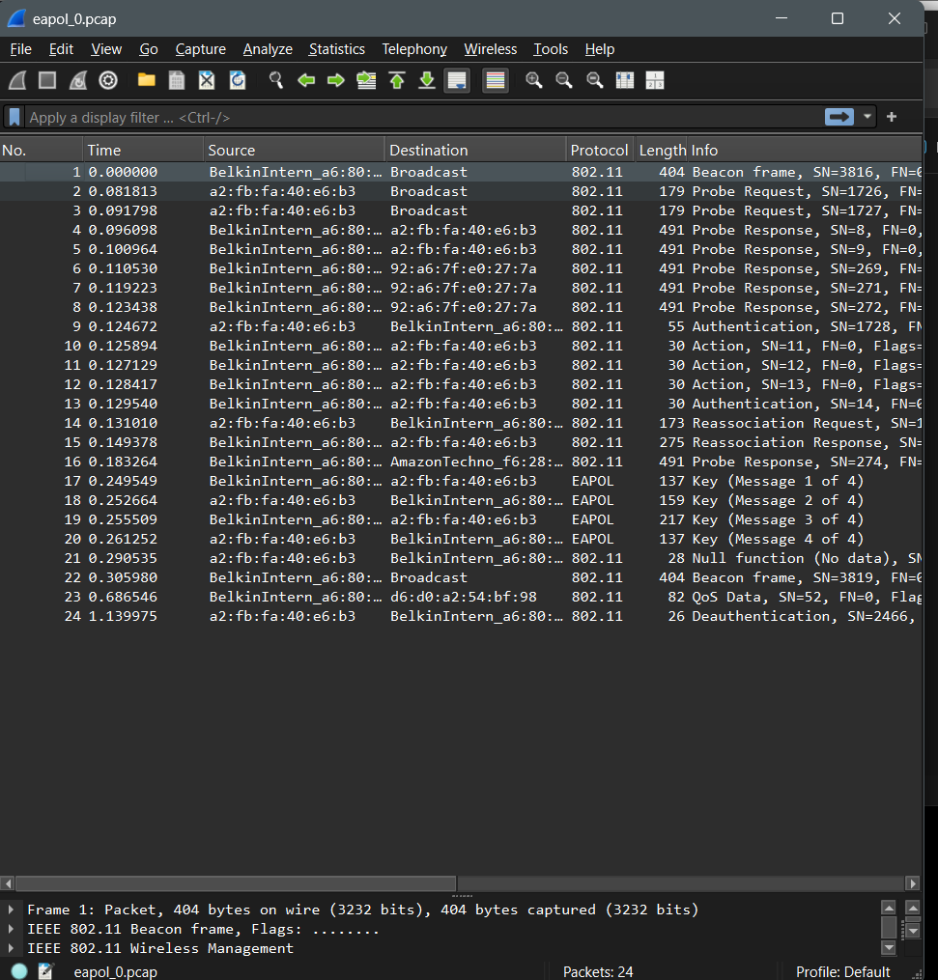
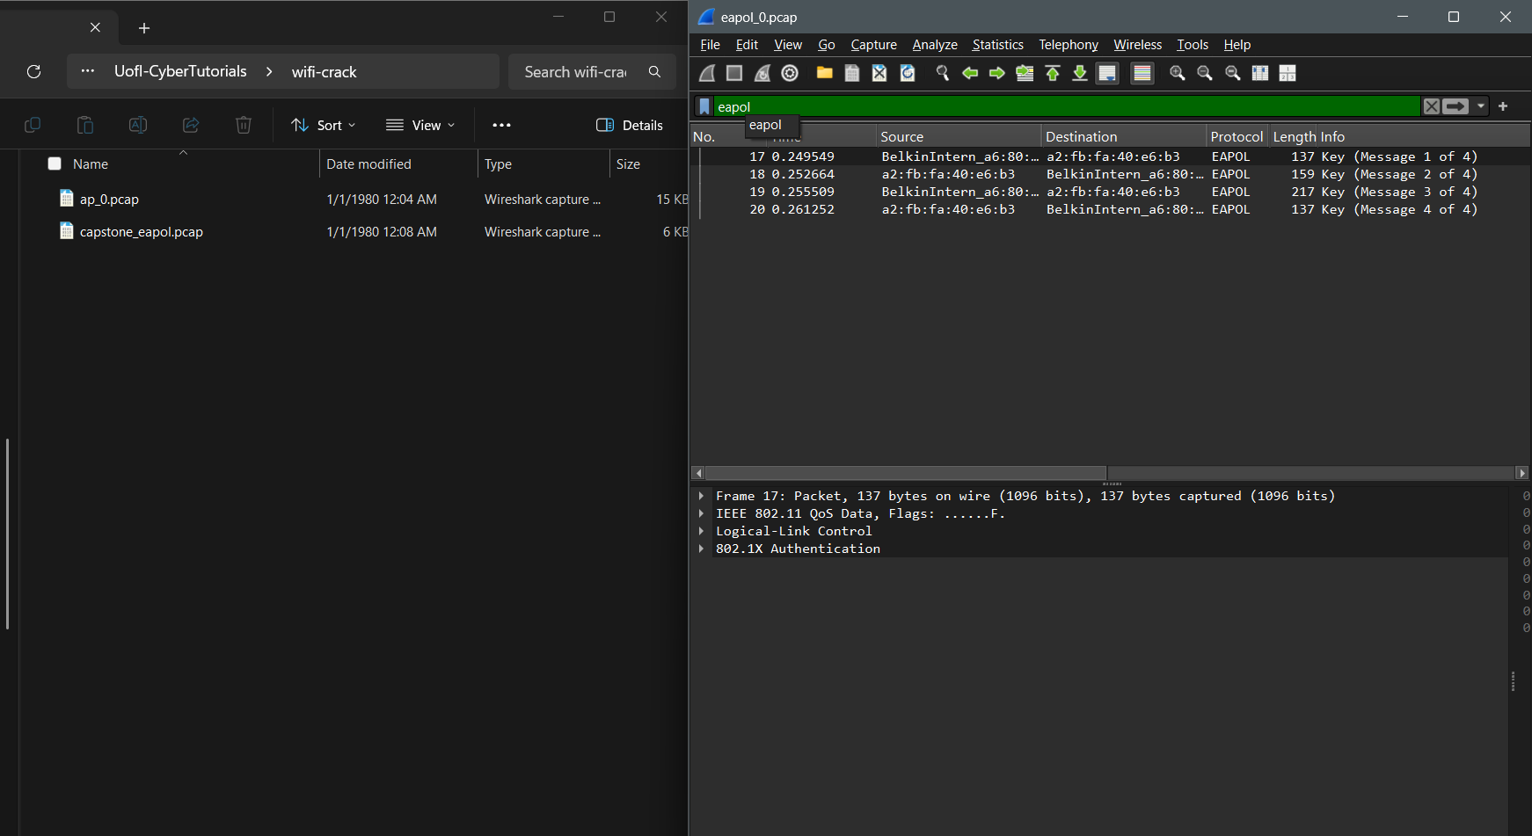
Reviewing Captures in Wireshark
Opened the PCAPs in Wireshark on the laptop.
Confirmed presence of the 4‑way WPA2 EAPOL handshake messages.
Notes:
Slide 14 – Reviewing Captures in Wireshark
“Phase 4 was validation. I pulled the PCAPs off the SD card and opened them in Wireshark.
I confirmed that:
The capture contained the right SSID and BSSID
And that there was a complete WPA2 4-way handshake—messages 1 through 4 of EAPOL.
If you don’t verify this step, you can waste a lot of time trying to crack a bad capture.”

Slide 15
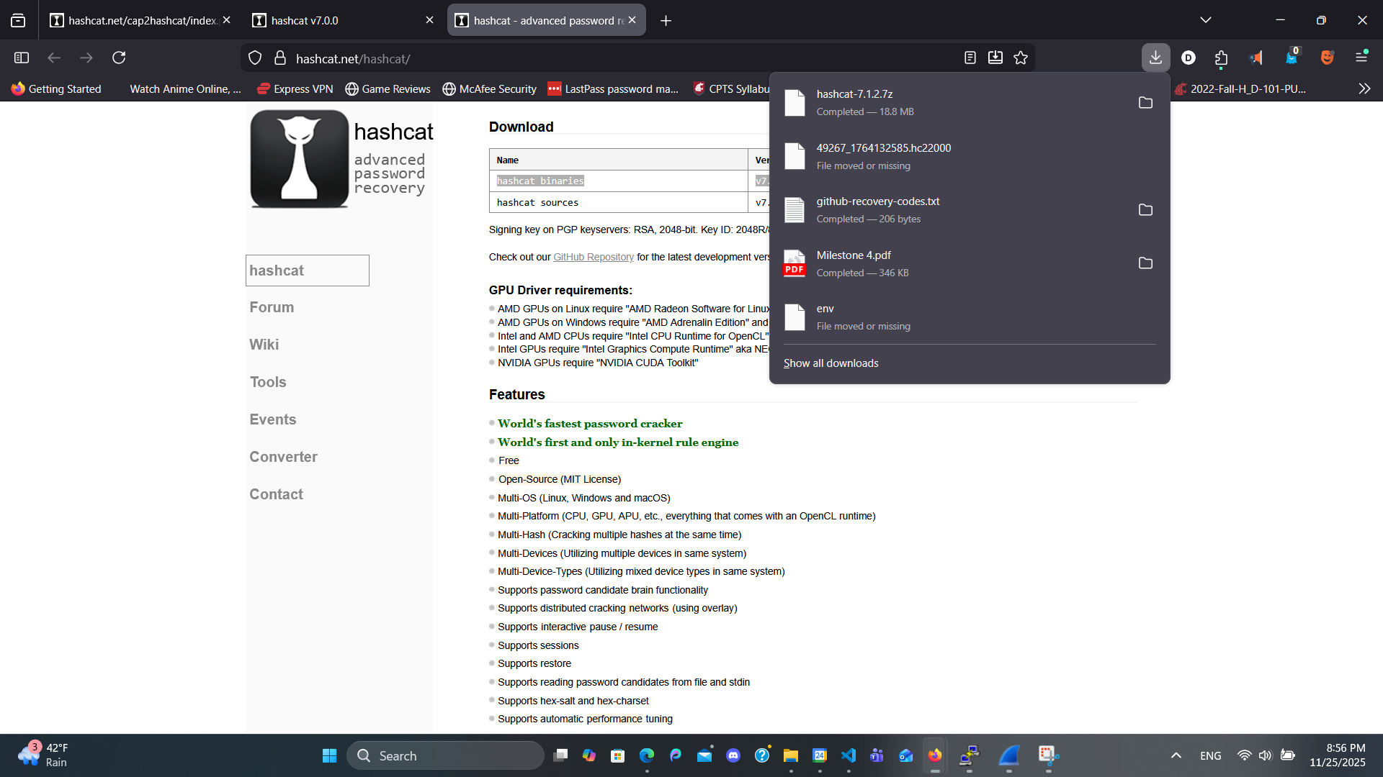
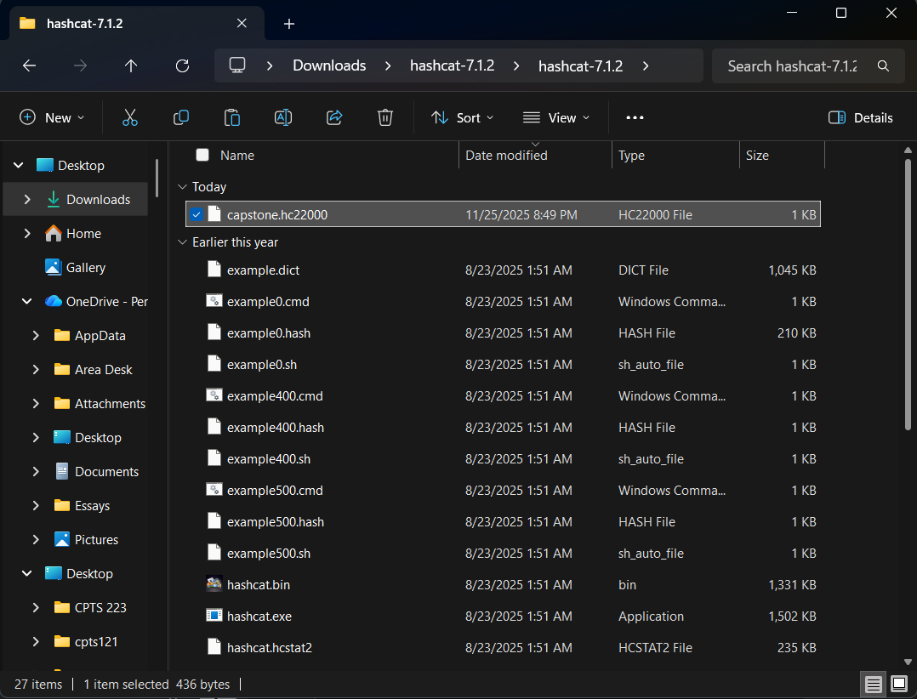
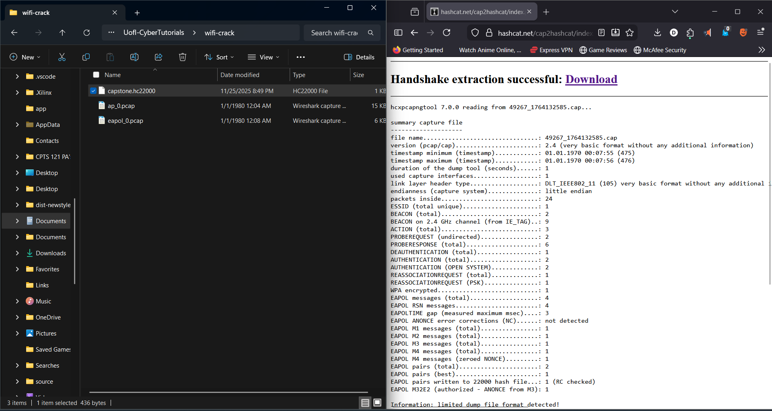
Converting PCAP to Hashcat Format
Uploaded the capture to the cap2hashcat tool.
Downloaded the generated capstone.hc22000 file for WPA2‑PMKID+EAPOL cracking.
Notes:
Slide 15 – Converting PCAP to Hashcat Format
“Phase 5 was converting the capture into something Hashcat understands. I uploaded the PCAP to the cap2hashcat tool, which generated a file called capstone.hc22000.
That file encodes the PMKID/EAPOL data plus the network identifiers so Hashcat can attempt to recover the pre-shared key.”

Slide 16
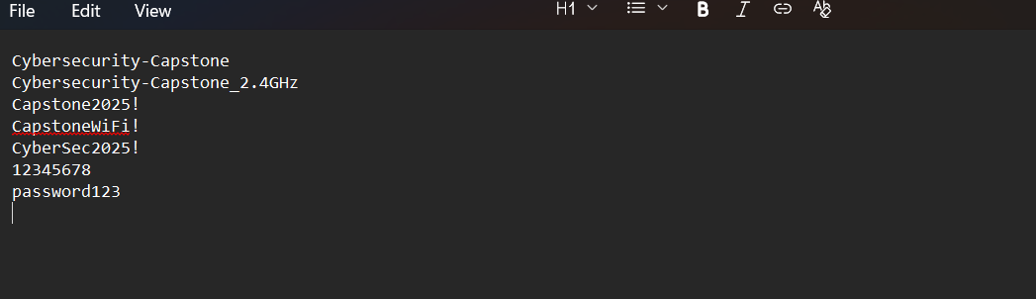
Creating a Targeted Wordlist (Attempt 1)
Built a short custom wordlist based on SSID and common weak passwords.
Saved it as wordlist.txt in the Hashcat directory.
Notes:
Slide 16 – Creating a Targeted Wordlist (Attempt 1)
“In Phase 6, I built my first targeted wordlist. I started with:
Variations of the SSID
Simple patterns like Capstone2025!
And a couple of very weak defaults like 12345678 and password123.
I saved this as wordlist.txt in the Hashcat directory.”

Slide 17
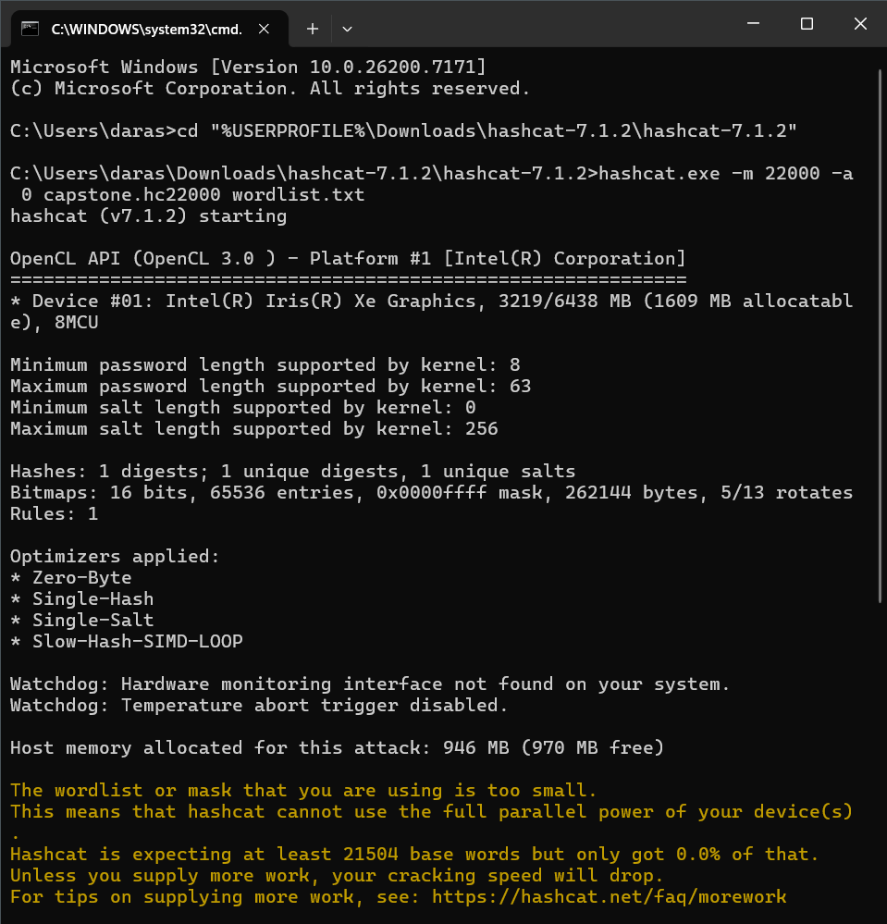
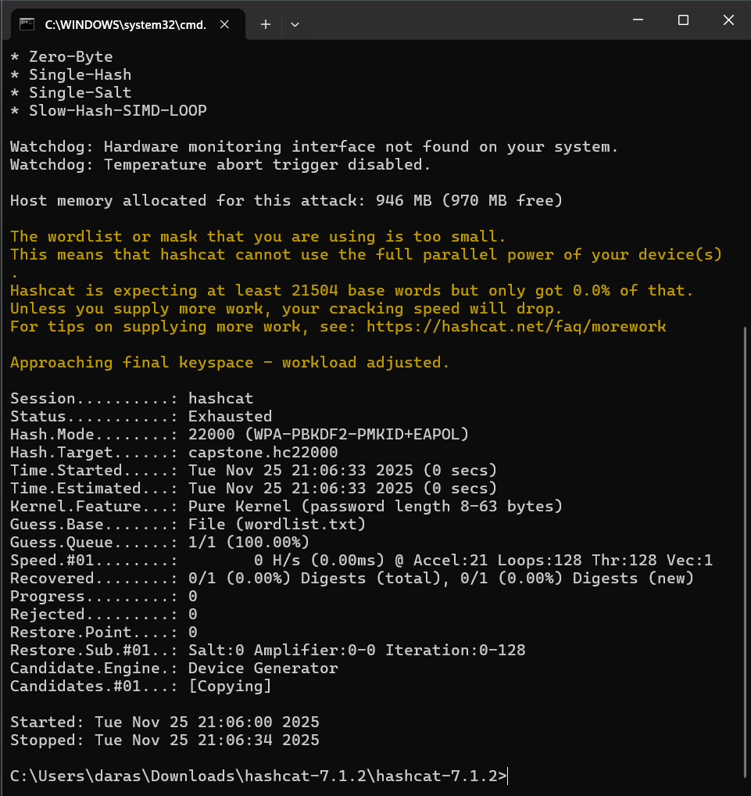
Hashcat Attempt 1: No Match
Ran Hashcat with: hashcat.exe -m 22000 -a 0 capstone.hc22000 wordlist.txt
Hashcat warned that the dictionary was too small and the session ended 'Exhausted'.
No password was recovered in this first attempt.
Notes:
Slide 17 – Hashcat Attempt 1: No Match
“Phase 7 was my first Hashcat run: hashcat.exe -m 22000 -a 0 capstone.hc22000 wordlist.txt
Hashcat immediately warned me that my wordlist was too small. It burned through all the candidates, and the session ended with status Exhausted and 0/1 digests recovered.
This was a good reminder that even with the right capture, a weak wordlist means no results.”

Slide 18
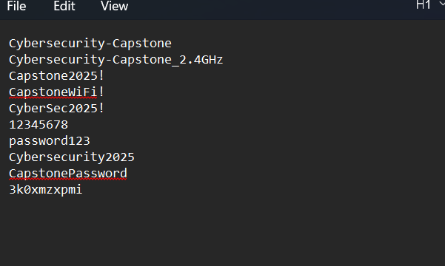
Improving the Wordlist (Attempt 2)
Expanded wordlist with more realistic variations and policy‑style secrets.
Included the actual capstone passphrase pattern used for the lab router.
Notes:
Slide 18 – Improving the Wordlist (Attempt 2)
“For Phase 8, I went back and expanded the wordlist. I used more realistic patterns, like combinations of:
The SSID
Year-based numbers
And shorter, random-looking strings that fit typical lab policy.
This second wordlist still wasn’t huge, but it was much closer to how people actually choose Wi-Fi passwords.”

Slide 19
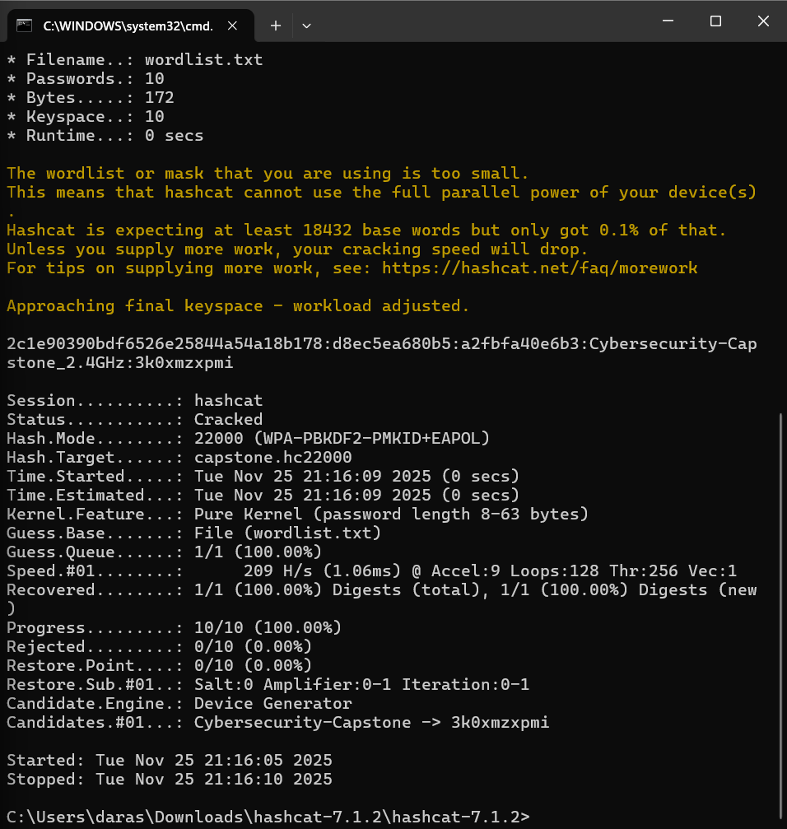
Hashcat Attempt 2: Password Cracked
Reran Hashcat with the improved wordlist.
This time Hashcat reported Status: Cracked and recovered 1/1 digests.
Recovered candidate: Cybersecurity‑Capstone_2.4GHz → 3k0xmzxpmi (lab passphrase).
Notes:
Slide 19 – Hashcat Attempt 2: Password Cracked
“Phase 9 was the successful run. I re-ran Hashcat with the improved wordlist, and this time:
The status changed to Cracked
Progress hit 100%
And Hashcat printed the recovered candidate: Cybersecurity-Capstone_2.4GHz → 3k0xmzxpmi
That’s the pre-shared key for the lab router.
So we completed the full chain: handshake capture → format conversion → dictionary attack → recovered password.”

Slide 20
Ethics and Legal Considerations
Only attack networks you own or where you have explicit written permission.
Handle PCAPs and recovered passwords as sensitive data and store them securely.
Use these techniques to harden Wi‑Fi security, not to access unauthorized networks.
Notes:
Slide 20 – Ethics and Legal Considerations
“I want to stress the ethical side of this:
Every attack I ran was against a lab router that I had explicit written permission to test.
These techniques are powerful and absolutely can be abused on real networks.
The point of this project is to show how attackers think so that we, as defenders, can:
Choose stronger passwords
Monitor for suspicious deauth and handshake activity
And harden our wireless configs, not to break into networks we don’t own.”

Slide 21
Summary and Lessons Learned
Built a working ESP32 Marauder from raw parts and fixed hardware issues.
Captured WPA2 handshakes/PMKID, verified them in Wireshark, and converted to Hashcat format.
Demonstrated dictionary‑based cracking and the impact of password strength.
Reinforced the importance of strong PSKs and ethical, permission‑based testing.
Notes:
Slide 21 – Summary and Future Work
“To wrap up:
I built a working ESP32 Marauder from individual components and fixed real hardware issues like the SD card header.
I used it to capture WPA2 handshakes and PMKID, validated them in Wireshark, and converted them to Hashcat format.
Then I demonstrated a dictionary-based crack, including an initial failure and a successful second attempt once I improved the wordlist.
For future work, I’d like to:
Try larger, rule-based wordlists and maybe a dedicated GPU box to see how speed scales.
Experiment with different router configs and password strengths to measure how long they resist offline attacks.
And eventually turn this into a repeatable teaching lab, where students can safely practice wireless security with their own ESP32 builds.
Possibly move on to WPA3 pen testing and research that
Thanks for listening – I’m happy to answer any questions about the build, the tools, or the Wi-Fi cracking workflow.”

